Slide 1
Full stack web development
Using python & Django
NEPAL ASSOCIATION OF TOUR & TRAVEL AGENTS (NATTA) | FARWEST (nattasudurpaschim.com)
https://www.samriddhasudurpashchim.com/
Sudurpashchim Tourism Information, Manufacturers, Suppliers, Exporters & Importers from sudurpashchim province Nepal (supaidolbrand.com)
Welcome to Nimesh Community Hospital & Sickle Cell Research Center
https://www.meristophospital.org.np/

Slide 2
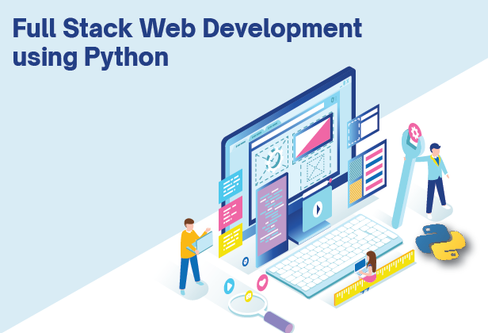
What is full stack web development ?
Full stack development is the process of developing both the frontend and backend of applications. Any application has a frontend (user-facing) and a backend (database and logic) component.
Full stack development भनेको एपहरूको फ्रन्टइन्ड
र ब्याकइन्ड दुवै निर्माण गर्ने प्रक्रिया हो।
कुनै पनि एपहरूको फ्रन्टइन्ड ( प्रयोगकर्ताले- देखने )
र ब्याकइन्ड (डेटाबेस लजिक र कोड) कम्पोनेन्ट हुन्छ।
फ्रन्टइन्ड भनेको प्रयोगकर्ताले- देखने इन्टरफेस हो र ब्याकइन्ड भनेको कोडको माध्यम बाट प्रयोगकर्ता लाइ database संग अन्तरक्रिया गर्ने माध्यम हो

Slide 3
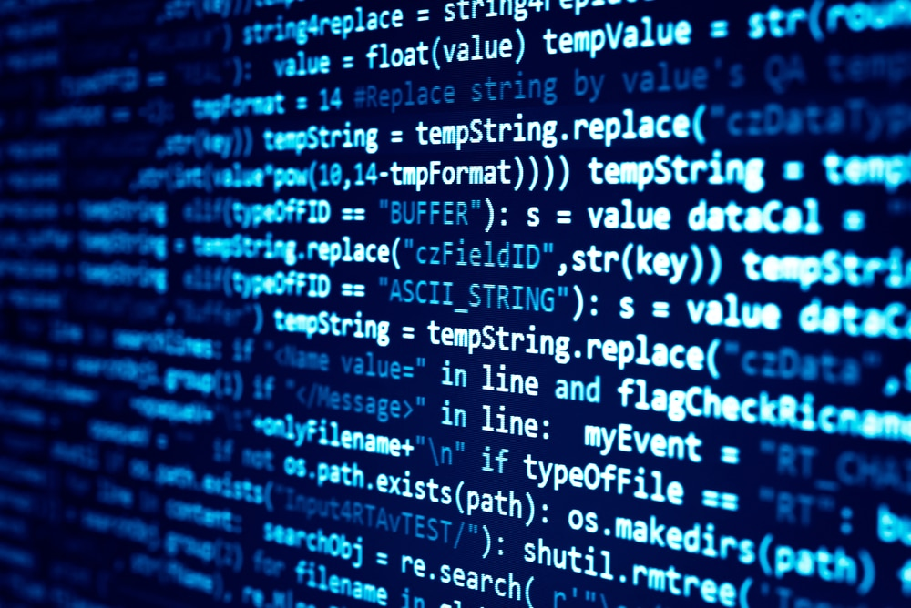
What is Computer Programming ?
Computer programming is the process of writing code to facilitate specific actions in a computer, application or software program, and instructs them on how to perform.
Computer Programming भनेको कम्प्युटर एप्लिकेसन वा सफ्टवेयर मा विशिष्ट कार्यहरू गर्नको लागि कोड लेख्ने प्रक्रिया नै computer programming हो

Slide 4
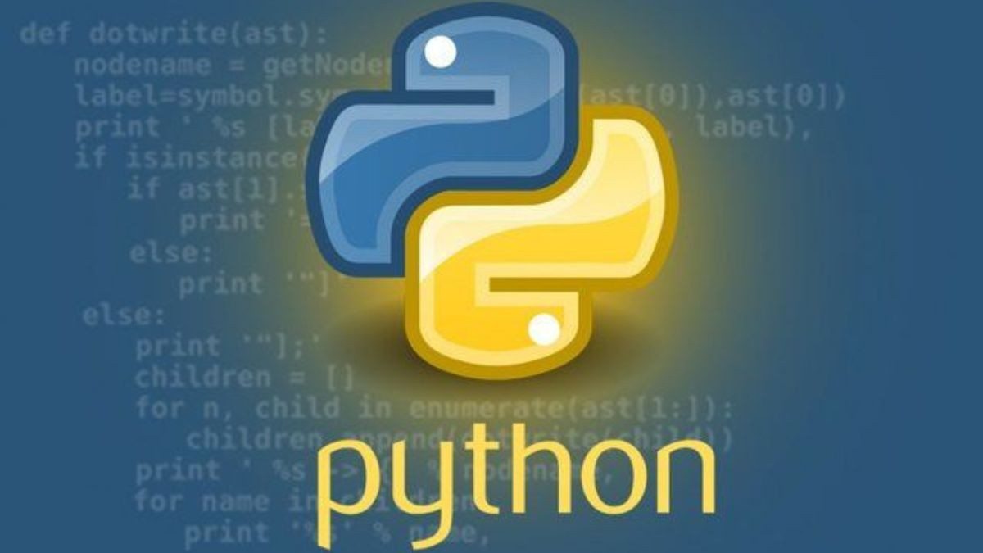
What is Python ? Why Developer use Python ?
Python is a object-oriented, high-level programming language. That is widely used in web applications, software development, data science, and machine learning (ML). Developers use Python because it is efficient and easy to learn and can run on many different platforms
Python एक object- oriented, high-level (उच्च-स्तर)
programming language (भाषा) हो।
यो व्यापक रूपमा web application, software development,
Data science, र machine learning (ML) मा प्रयोग गरिन्छ।
धेरै जसो Developer हरूले पाइथन प्रयोग गर्छन् किनभने यो
कुशल र सिक्न सजिलो छ र यो फरक फरक प्लेटफर्महरूमा
सजिलै चल्न सक्छ

Slide 5
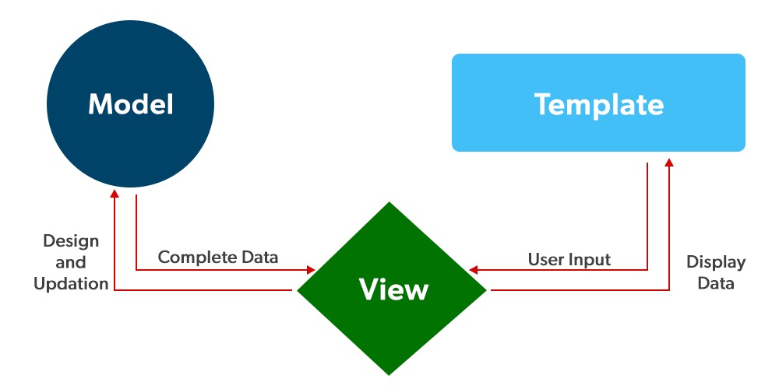
What is Django Framework ?
Django is a Python framework that makes it easier to create web sites using Python. (MVT Model)
Popular Python Framework
Django
Flask

Slide 6
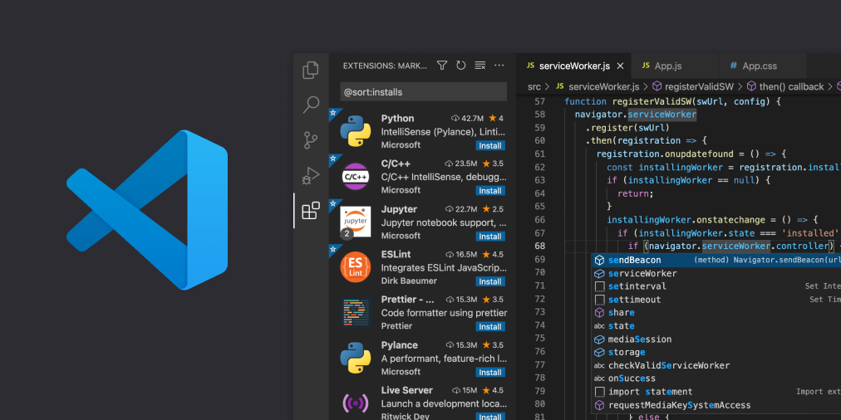
How to Create first Python Django Project ?
Setup Visual Studio code for Python and Django
1
Install Visual Studio Code Editor
2
Install Python extension for Visual Studio Code
3
Open/Create Project base folder, Then open the base project folder on visual studio code
4
Go to terminal in visual studio code
5
Type the command line in terminal in visual studio code

Slide 7
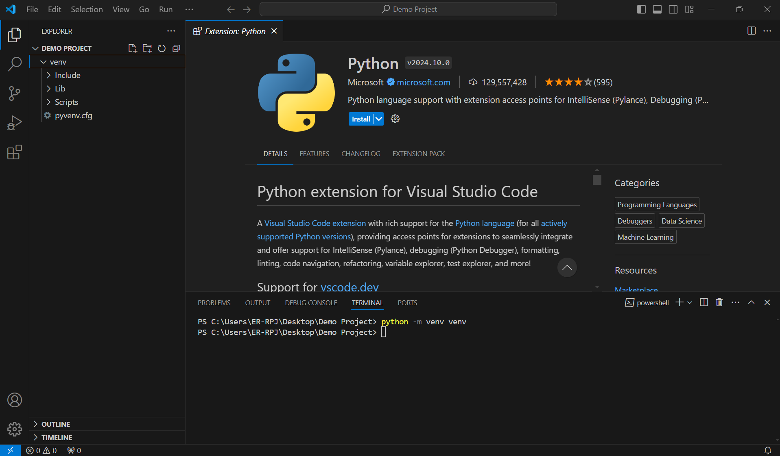
Virtual environment
Used to contain a specific Python interpreter and software libraries and binaries which are needed to support a project (library or application).
1
Virtual environment Command Line.
2
Python –m venv ( Virtual environment name like Venv )
3
Run the Virtual environment
Project path cd venv( Virtual environment Name) /Scripts/activate
Incase power shell not work use cmd prompt
Go back to project folder using cd.. cmd

Slide 8
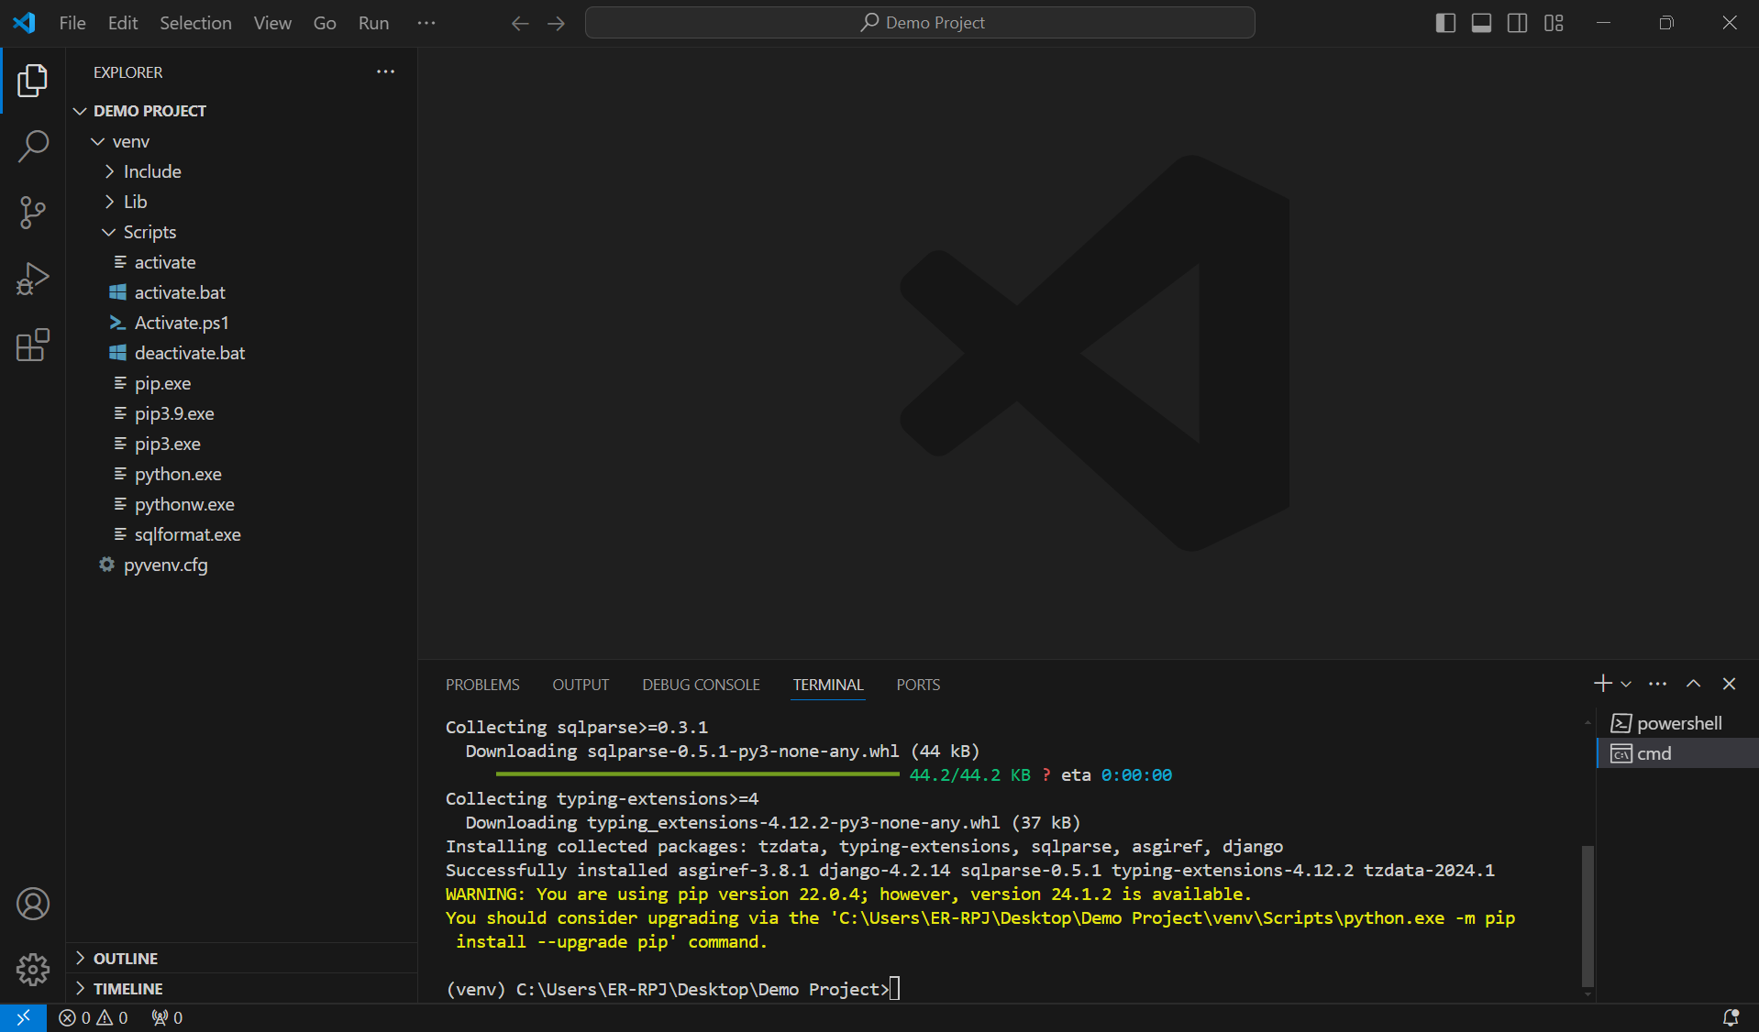
Install Django
Install Django by using pip command >pip install Django ((venv) C:\Users\ER-RPJ\Desktop\Demo Project>pip install Django )
Create project Core Django Project using >django-admin startproject demoProject(project name) . ((venv) C:\Users\ER-RPJ\Desktop\Demo Project>django-admin startproject demoProject . )
Run the python development server using > python manage.py runserver ( (venv) C:\Users\ER-RPJ\Desktop\Demo Project>python manage.py runserver )
Create Python app in Python project > python manage.py startapp main ( (venv) C:\Users\ER-RPJ\Desktop\Demo Project>python manage.py startapp main )
1
pip install Django
2
django-admin startproject your project name .
3
python manage.py runserver

Slide 9
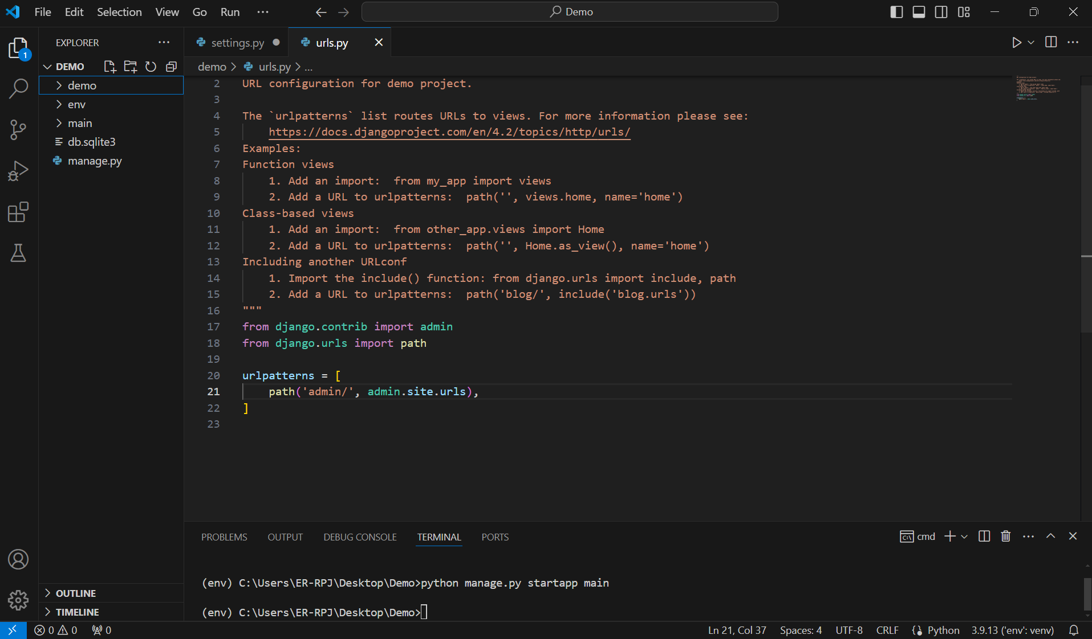
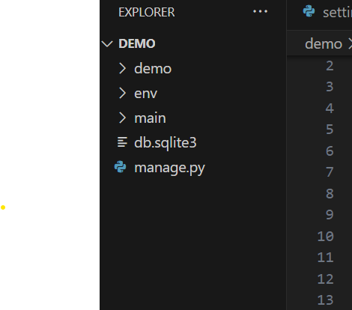
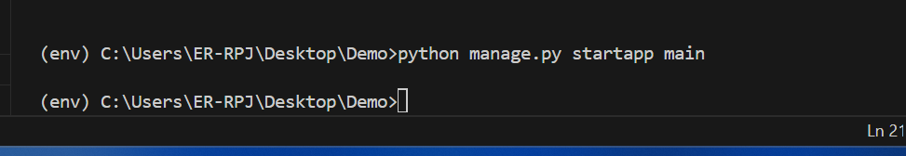
Create a First App in Django project
Go to the cmd prompt type >python manage.py startapp main (your app name) command

Slide 10
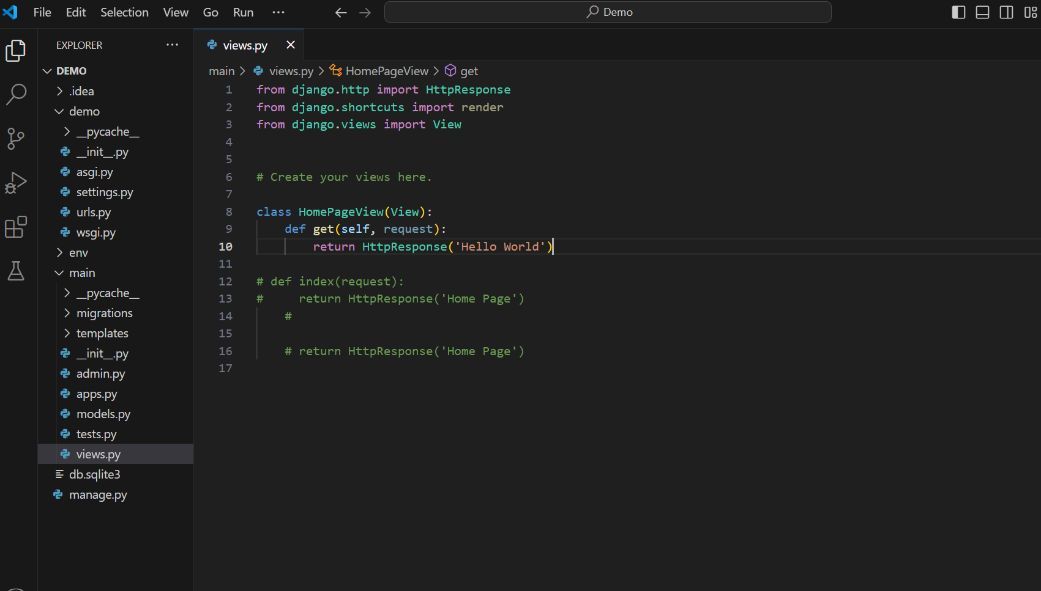
Class based view in non-separate Urls / project based urls
Import this libraries
Create a first class based view
Named by your wish, in my case (HomePageView)
In main app
Inside views.py files

Slide 11
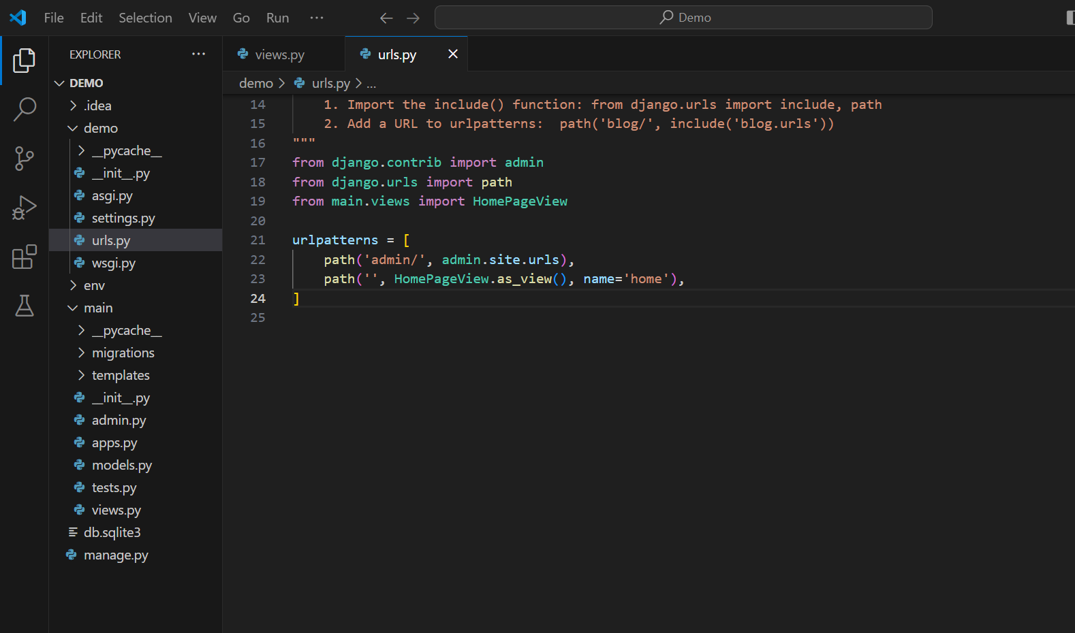
In Project folder
Import Class from main app folder
in views.py file, which you already
Created in my case
(HomePageView) class
In urls.py file
In urlspatterns add your home page pate
Like this

Slide 12
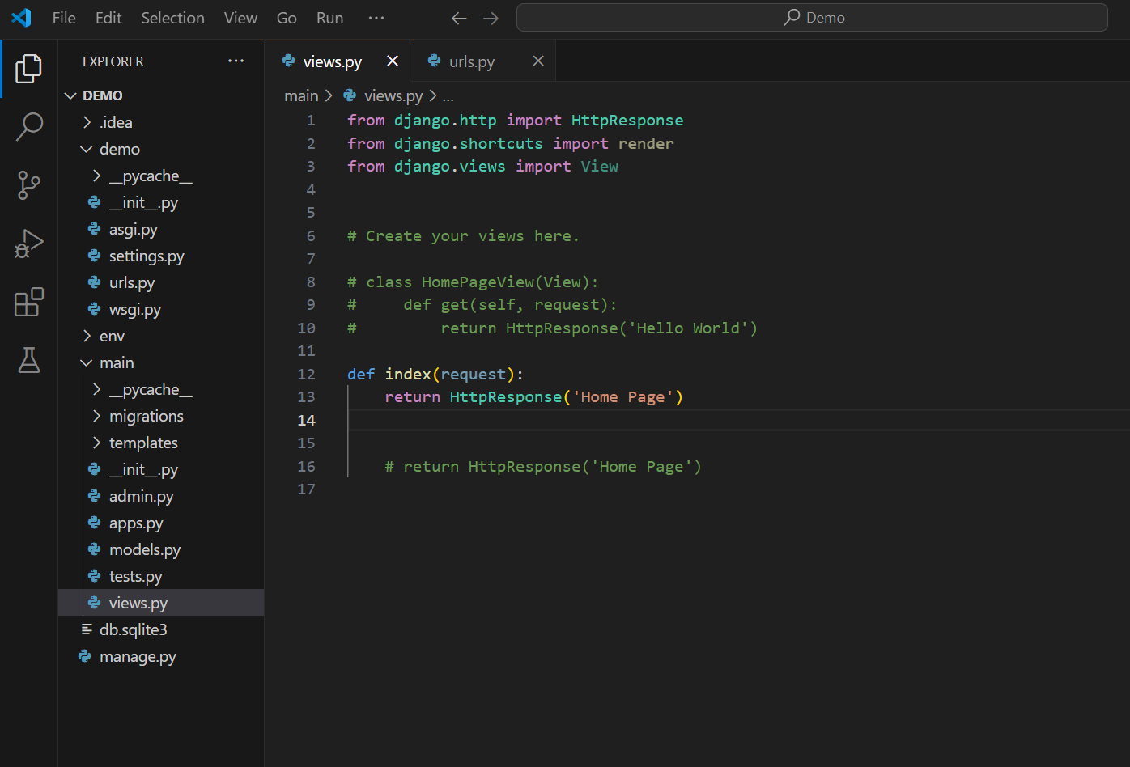
If you want function based view in non-separate Urls / project based urls
Import Library
In main app folder
Write this function
Named you wish,
In my case (index)
In Views.py File

Slide 13
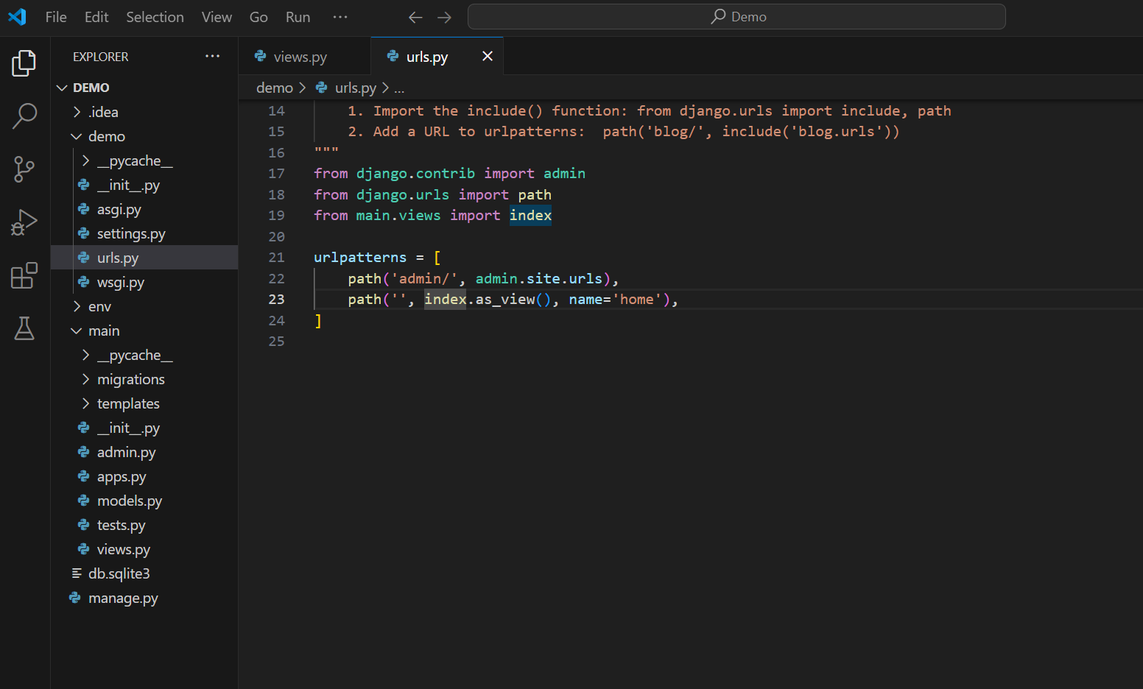


Import index function from
Main app in views.py file
Add to path for home page

Slide 14
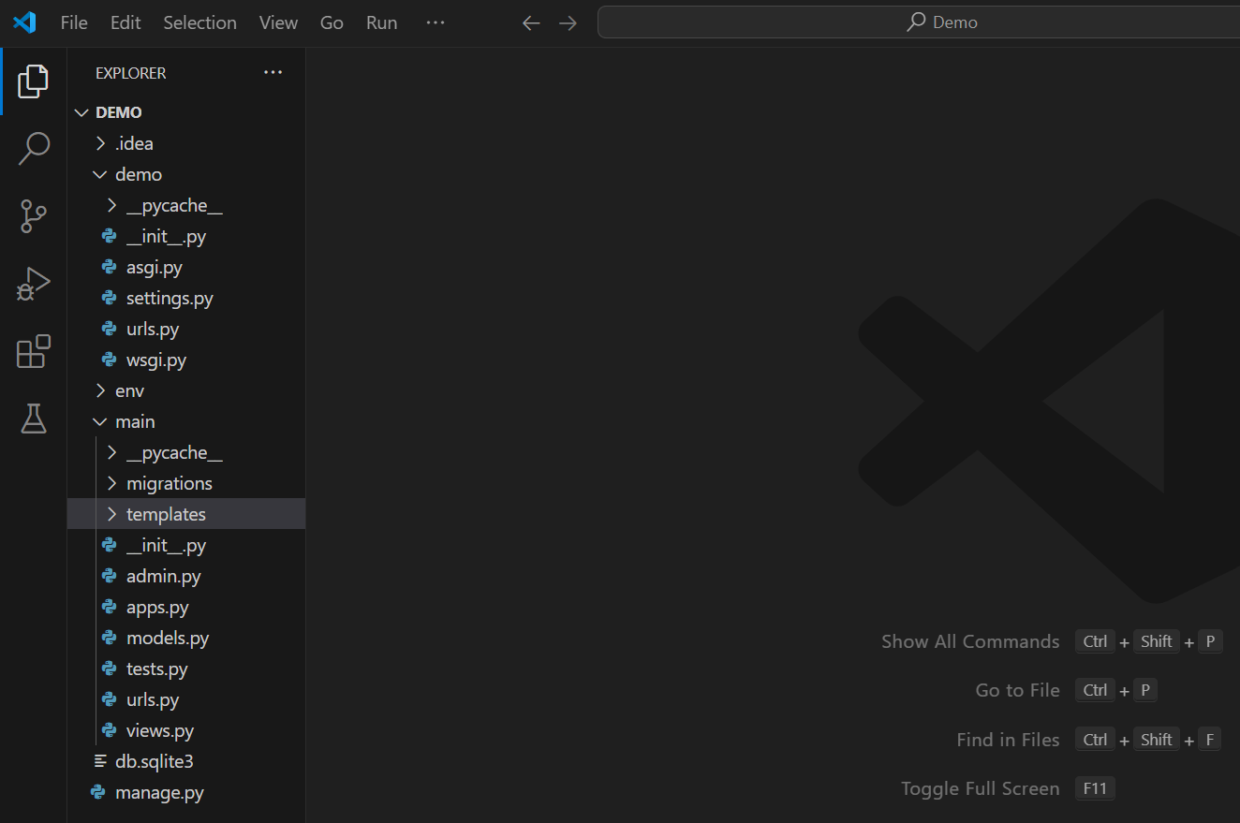
Stape 1 :- Class based view with separate Urls / App based urls
In Main app folder
Create a templates folder

Slide 15
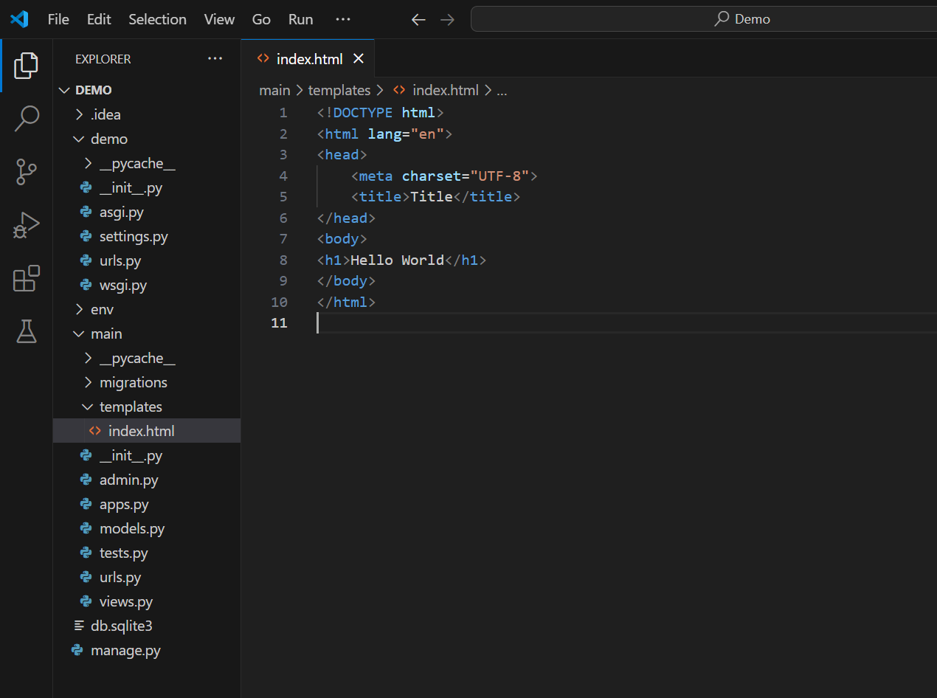
Stape 2:- Inside templates folder
Inside templates
folder create
index.html file
Write a basic html code on
index.html file
Like this index.html

Slide 16
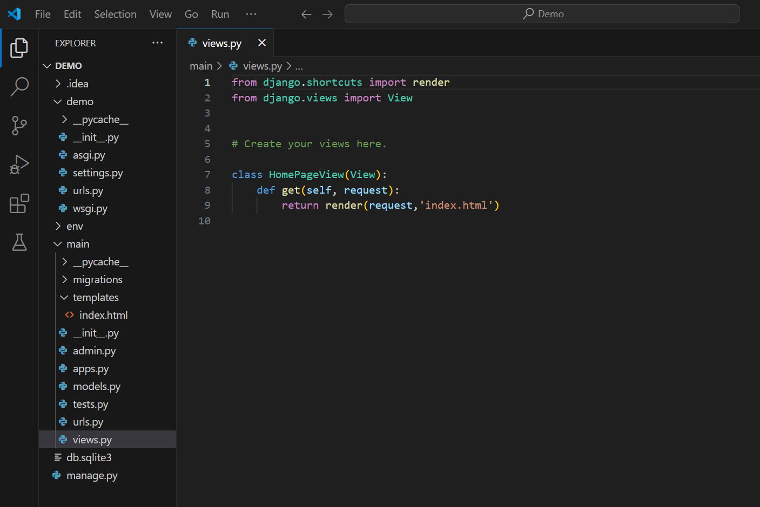
Stape :- 3 Inside main app folder , In views.py file
Create a class named a
(HomePageView) in my
case
In main app
folder
In views.py file

Slide 17
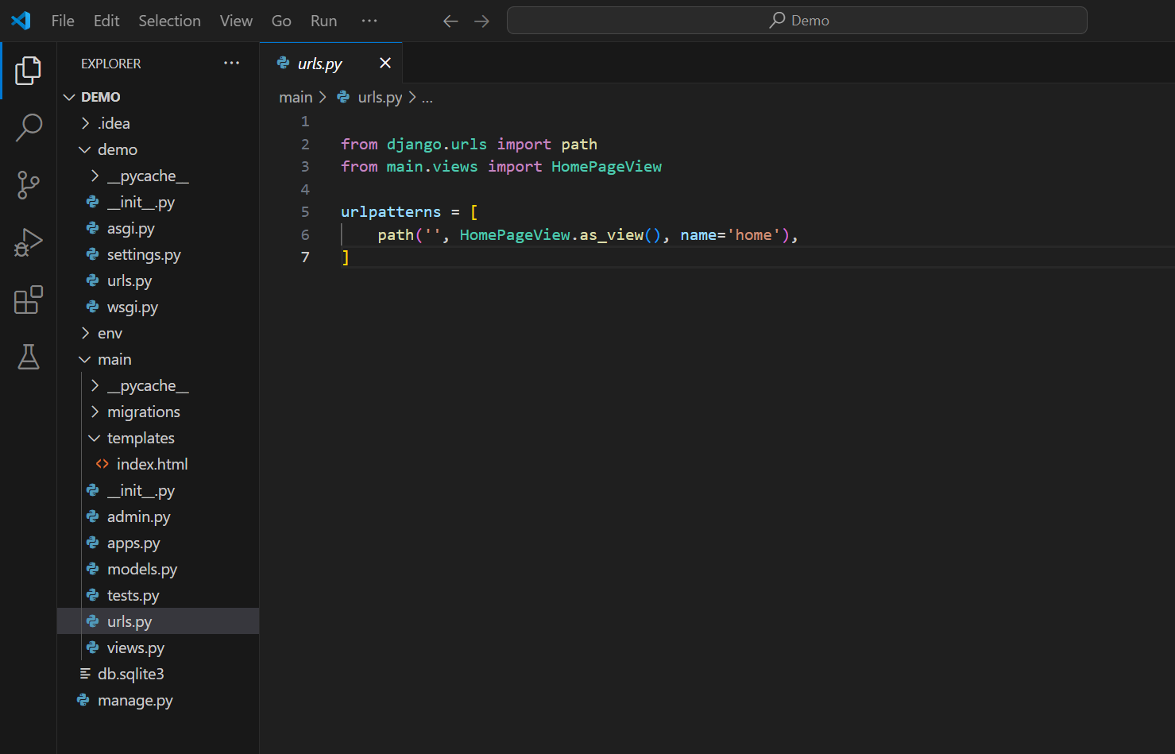
Stape :- 4 Create a urls.py file in main app folder
In urls.py file
Import (HomePageView) class
from main app folder in views file,
Which we already created in view.py file
Write this
code
In main app folder
Create a urls.py file
Like this

Slide 18
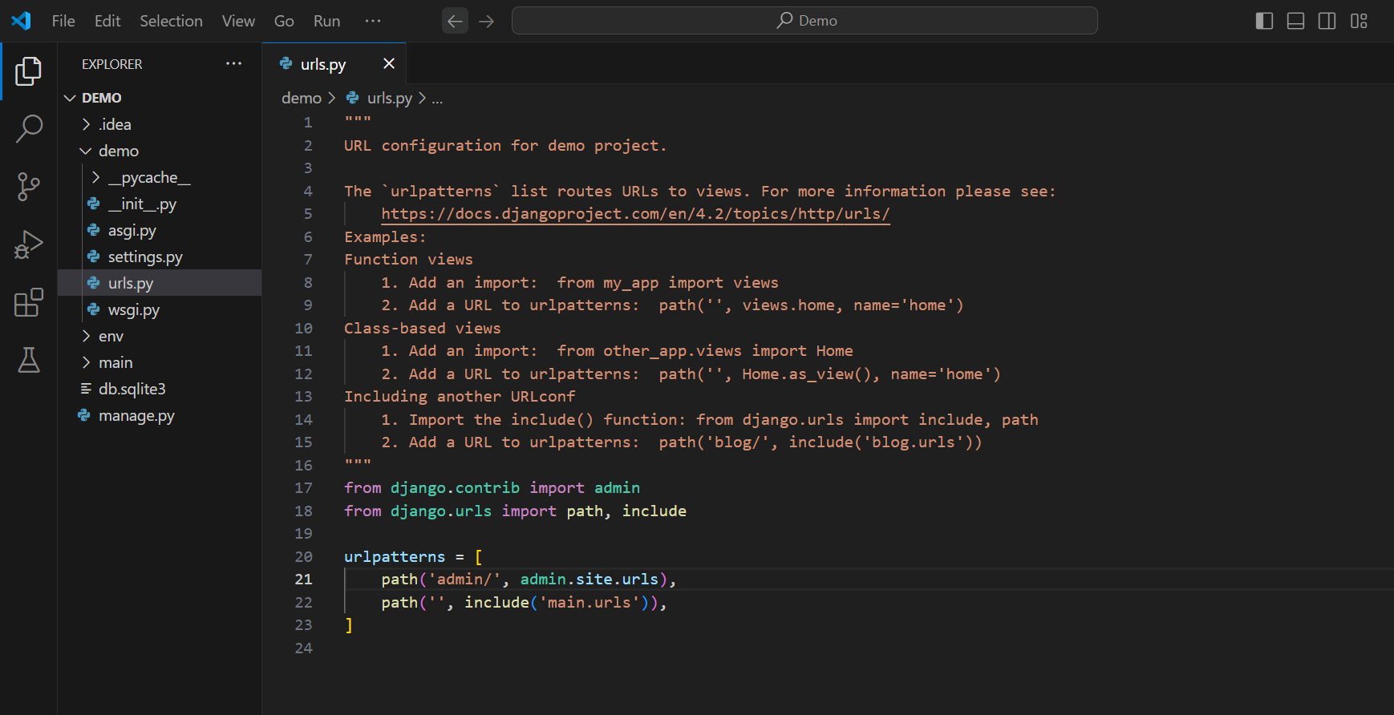
Stape :- 5 Include main app folder urls.py in demo base project urls.py
In project base
demo folder
Inside urls.py file
Import include library
Add this path
Import from main app, urls.py file is
Inside of main app folder

Slide 19
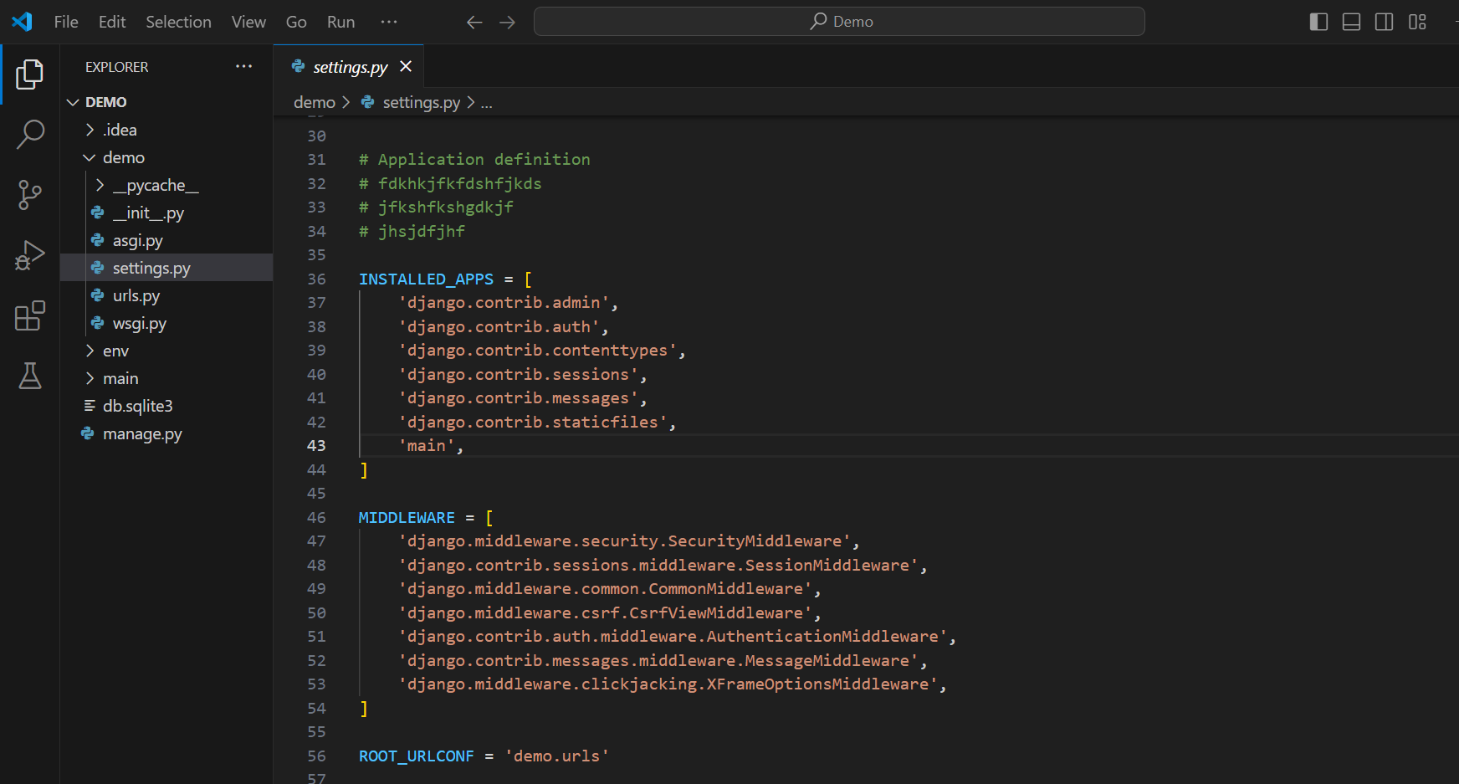
Stape:- 6 Install main app folder in settings.py file
In demo project
base folder
In settings.py file
In INSTALLED_APP Section
Add main app folder like this
Open settings.py file

Slide 20
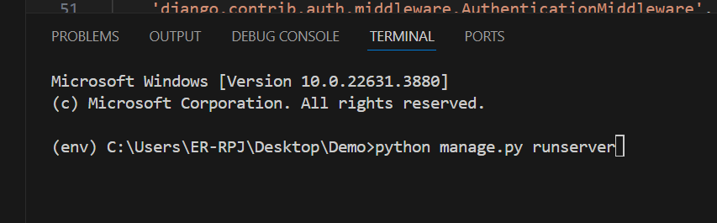
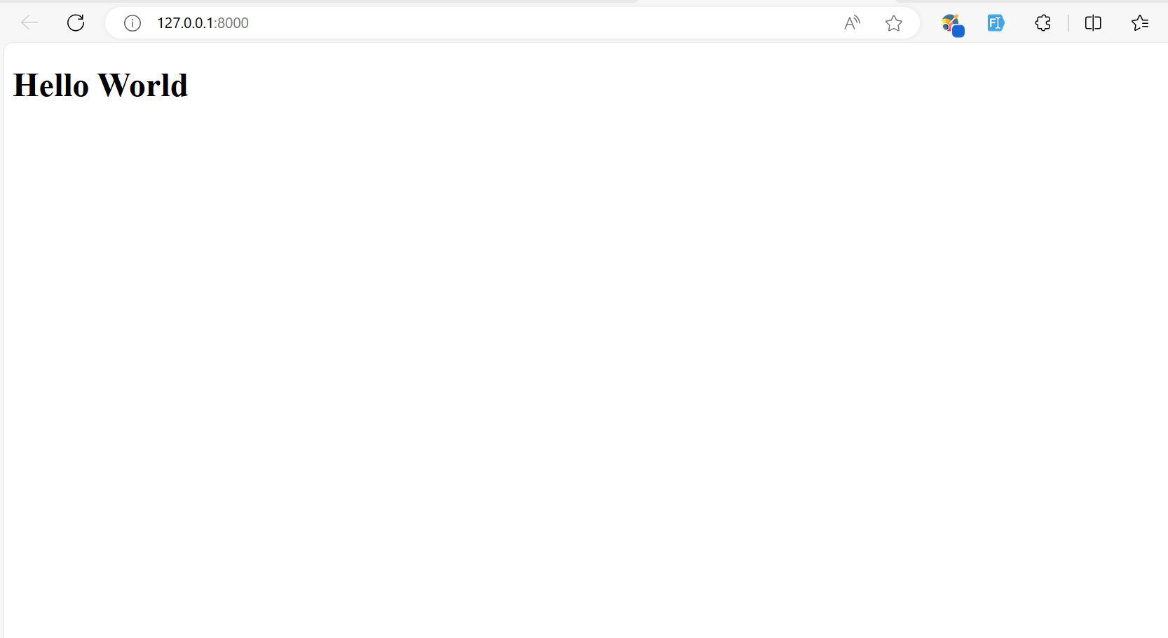
Run the python Server python manage.py runserver
This is the output in your browser
Type this cmd in command prompt

Slide 21
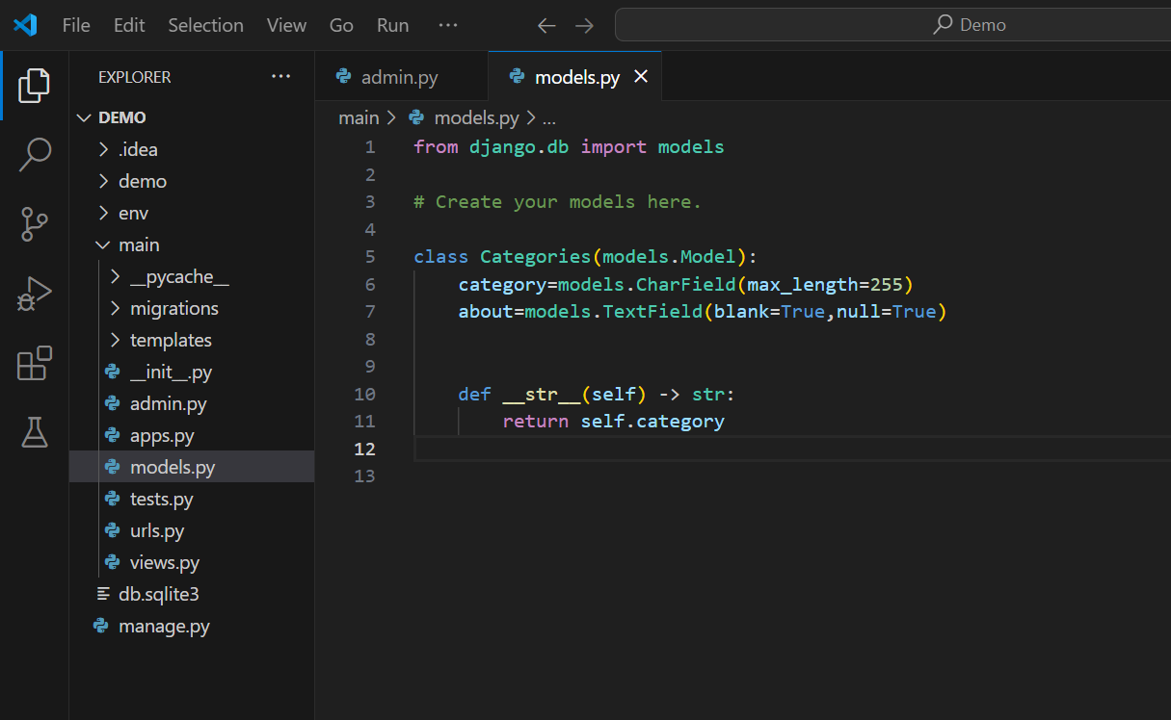
Dynamic Web Development (Model based ) Design a data base
In main app folder
Create a
Category
model
Open models.py folder

Slide 22
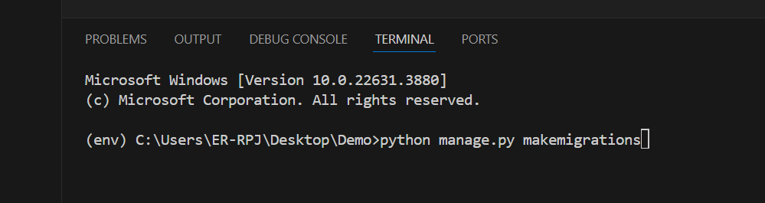
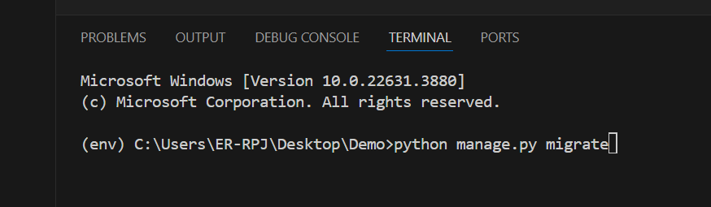
Migrations and Migrate model database
1:- In cmd prompt type > python manage.py makemigrations cmd
2:- In cmd prompt type > python manage.py migrate cmd
Make sur virtual environment
Is running
Like this
Make sur virtual environment
Is running
Like this

Slide 23
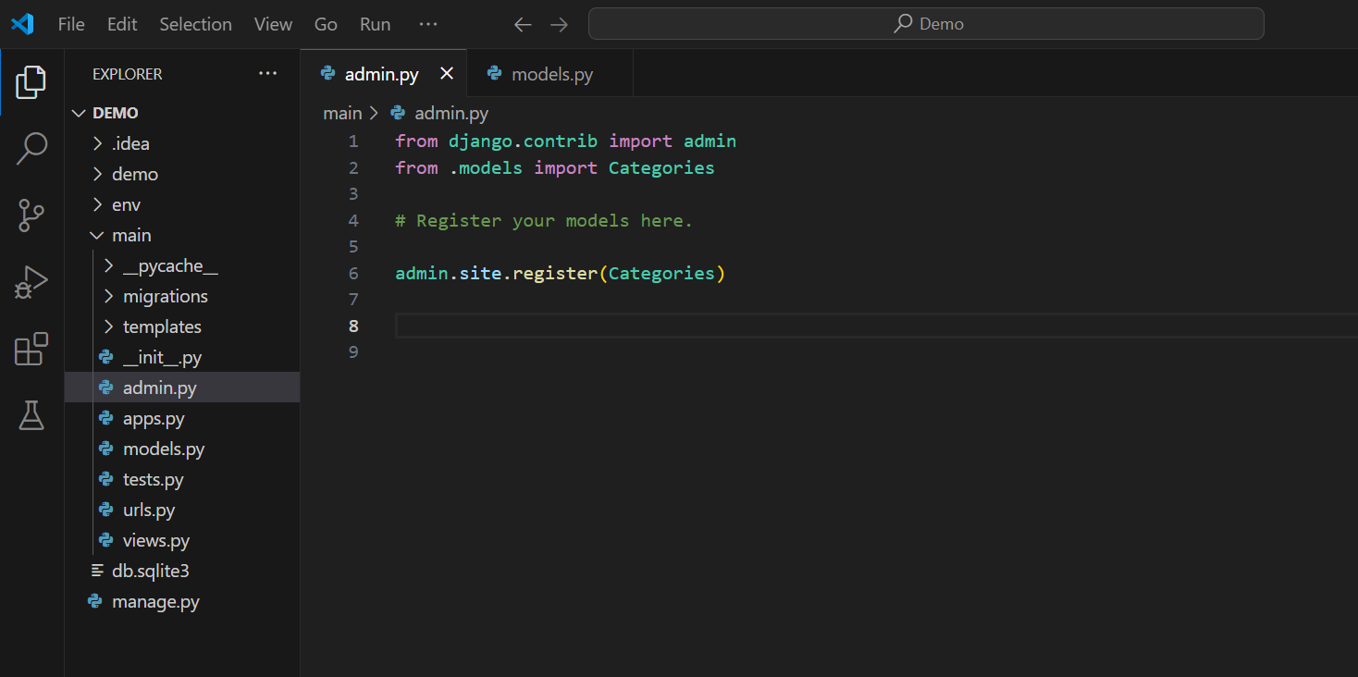
Add a Category Data table in Admin Site
In main app
Import Category model form
main app> models.py
Register this Categories model in admin Site
Open admin.py file

Slide 24
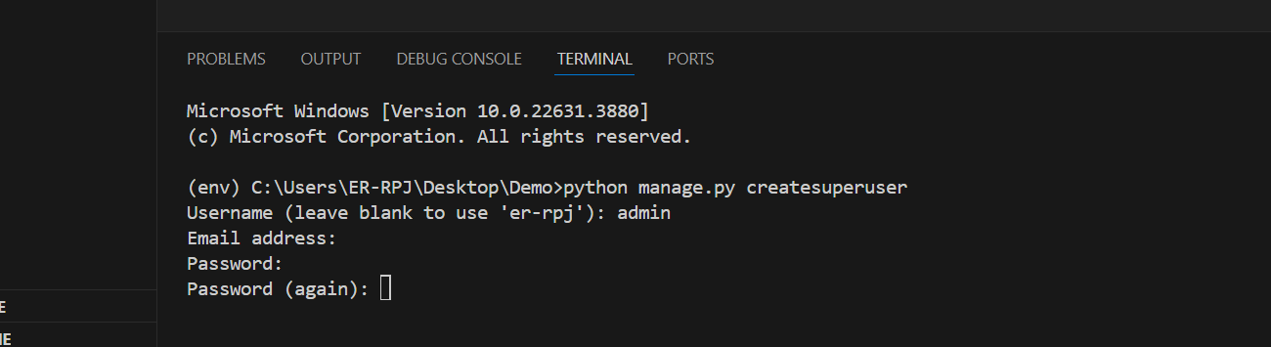
Create A superuser for admin panel
1. In cmd prompt type > python manage.py createsuperuser cmd
Each Stape
Press Enter
Type this cmd in your project terminal
Your Email address, Skip option also
Type your new username my case (admin)
For you your choice
Give your password
Give your password again, for conform password

Slide 25
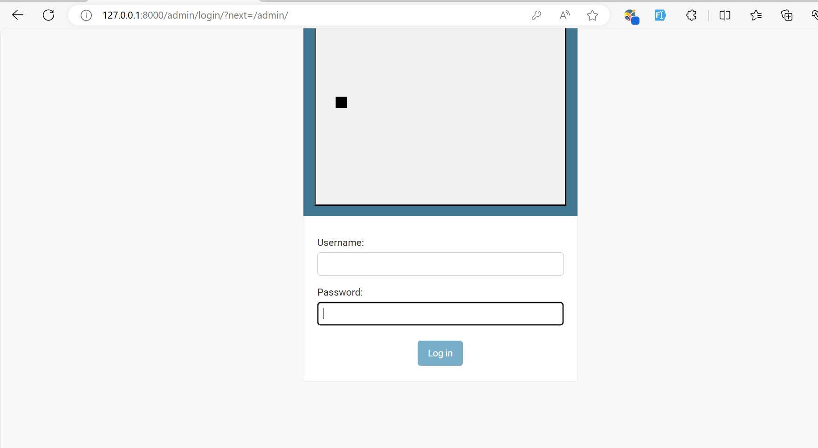
Login Admin panel using username and password, which you created
Username
Password

Slide 26
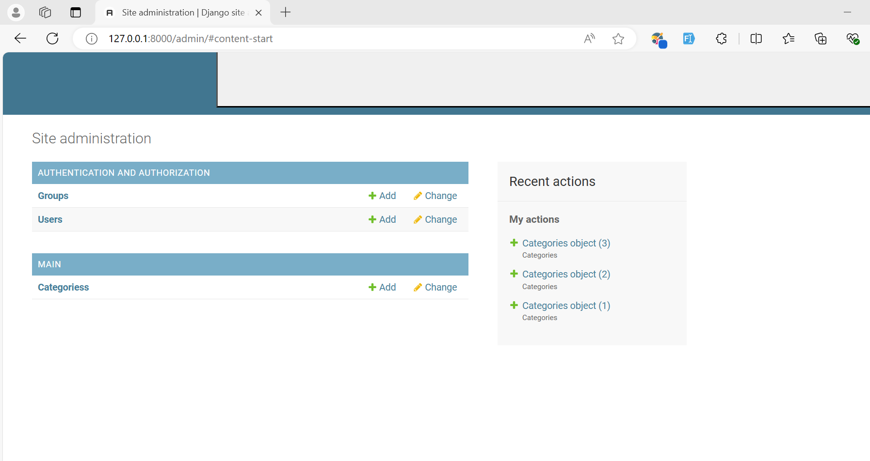
After login Admin Panel
This a user table Django
by default provide us
This is a Category table which we created
On models.py file

Slide 27
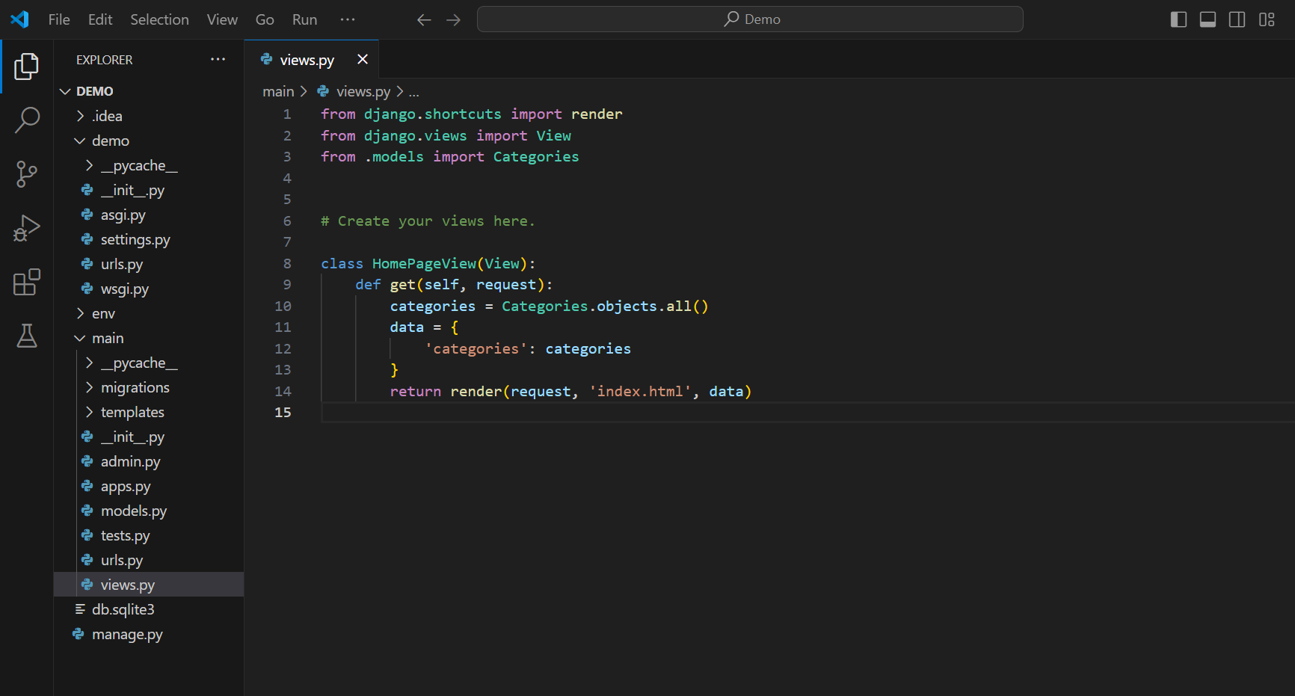
Retrieve Data from Categories table to index.htmp file (home Page)
Stape 1:-
Import Categories table
from models.py file
In main app folder
Write this
code in
HomepageView
class
Update HomePageView
class
In views.py files

Slide 28
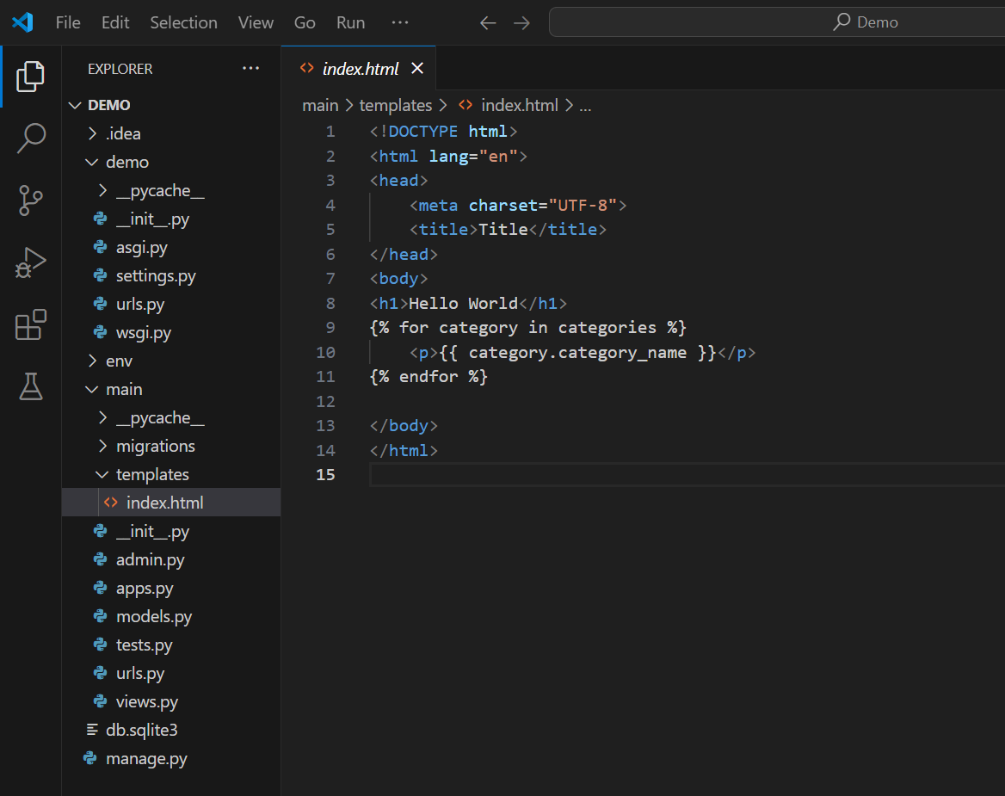
In index.html file
Stape 2
Import from HomePageView class
In data section
Variable
In main app folder
Create a
For loop
In templates folder
Category name from categories
table
Open index.html file
Then run the server

Slide 29
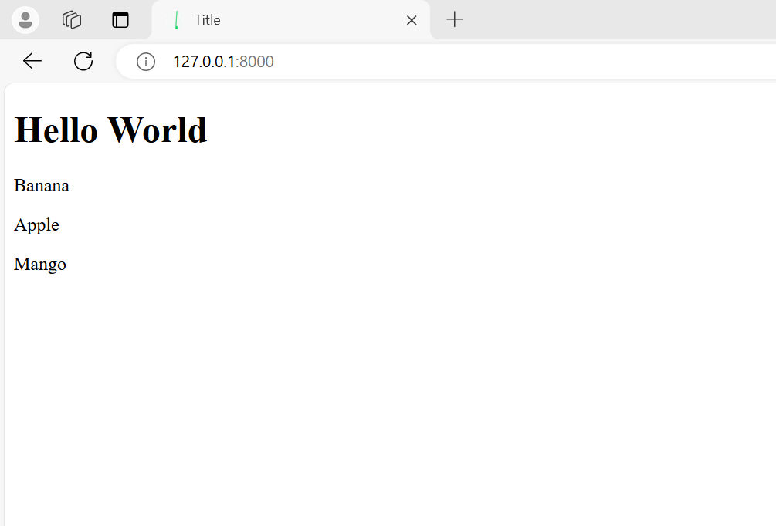
Output in Homepage
This is a final output
This data import from categorise table

Slide 30
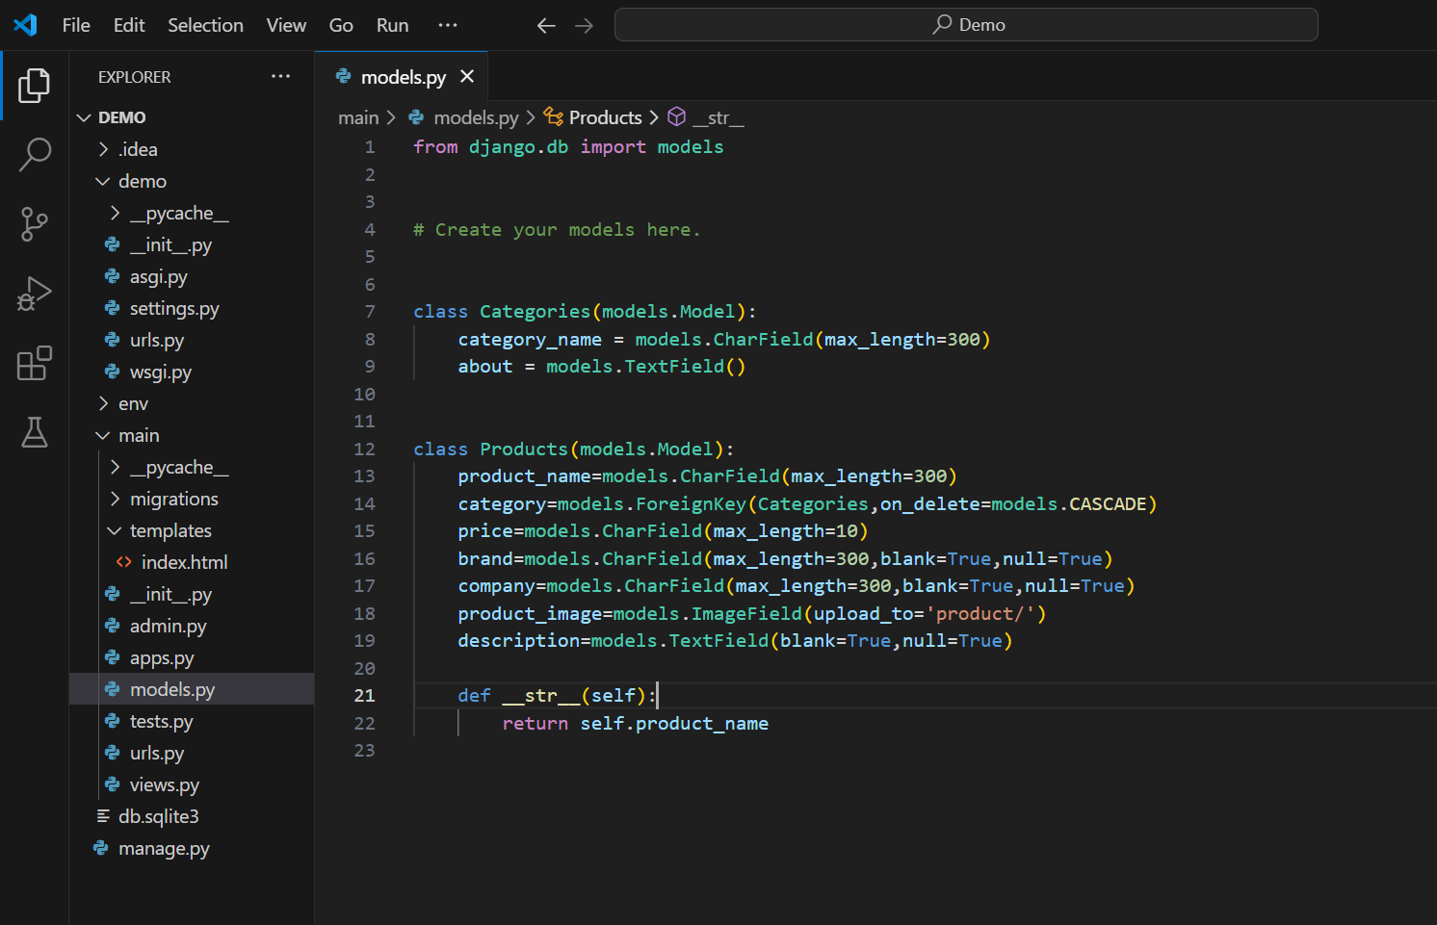
Create Product Table
In main app
Create a
Categories
Model table
Open models.py

Slide 31
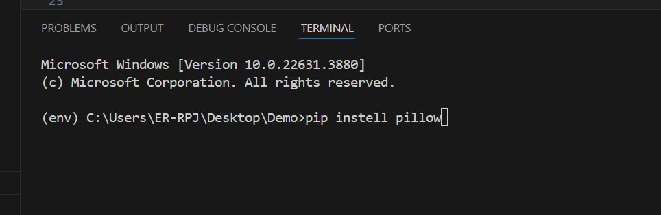
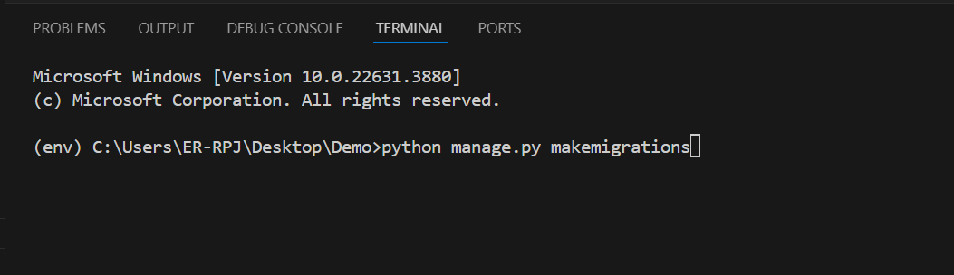
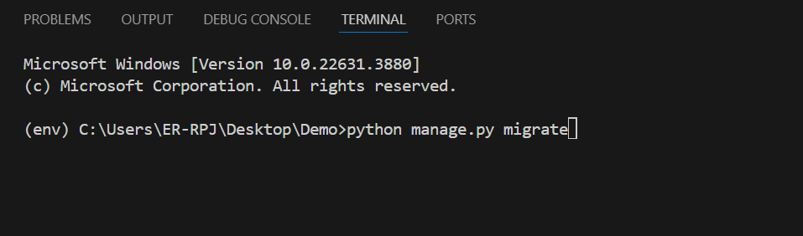
After create Product model table Make Migrations and Migrate
After create table start
Makemigrations
Typing this cmd on terminal
Stape 1
Stape 2
Install pillow using this cmd
For image loader
Migrate using this cmd on terminal
Stape 3

Slide 32
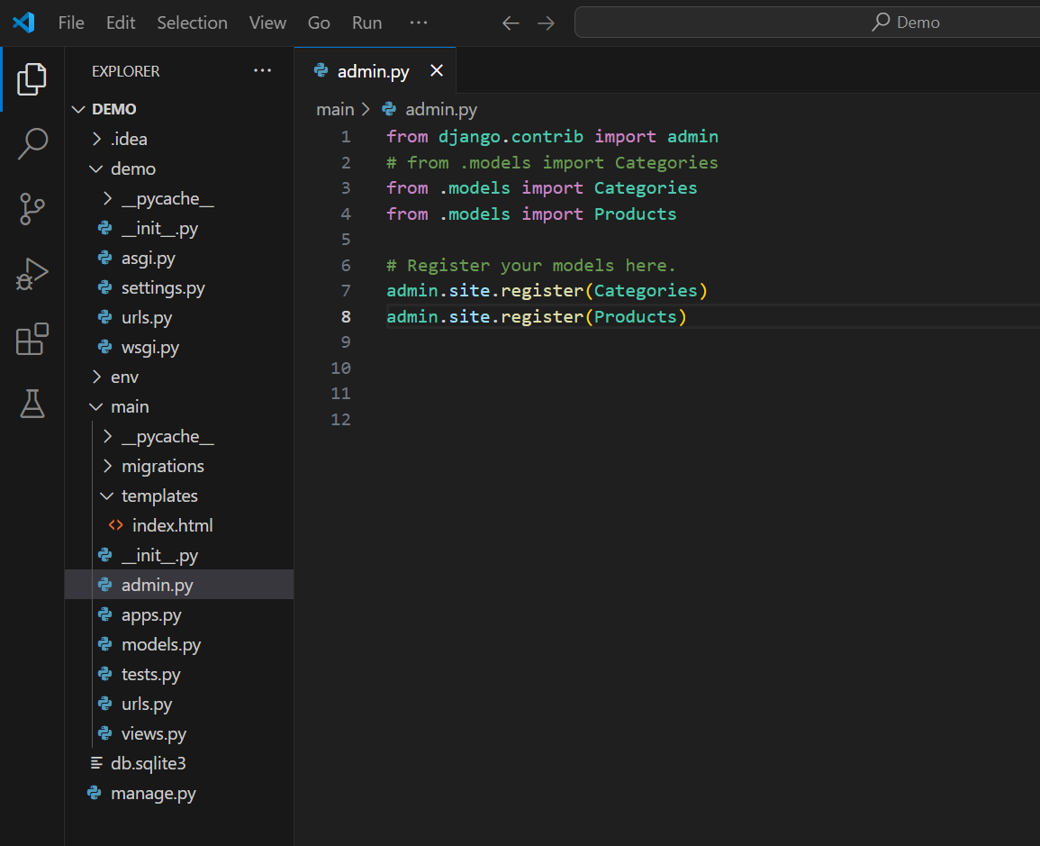
Register Product table in Admin site
Import Product
Table from
models.py
In main app
Register Product table
In admin site
Login Your Admin panel
And Add product in product
table
Open admin.py file

Slide 33
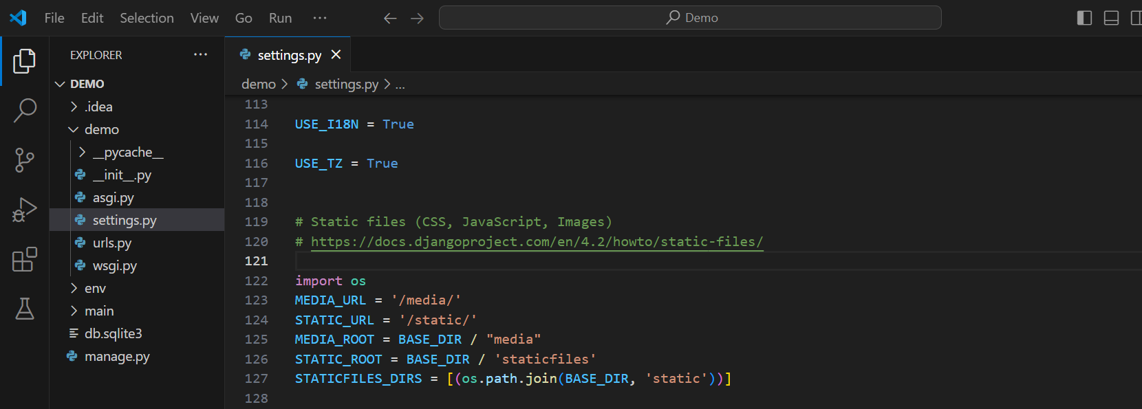
Media Directory, Static file setup in settings.py file
In project base folder
Open settings.py file
Write this code block
On your settings.py file

Slide 34
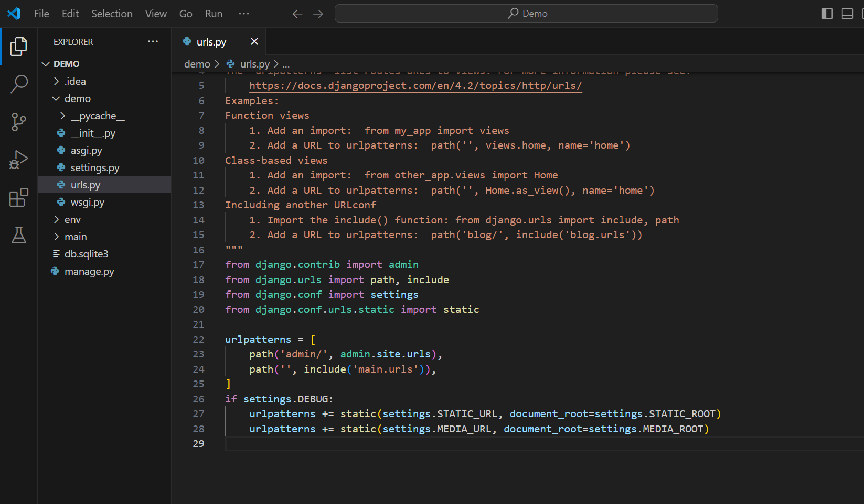
In Base project folder in urls.py file
In project base folder
Open urls.py file
Import this two library from django
Write this code

Slide 35
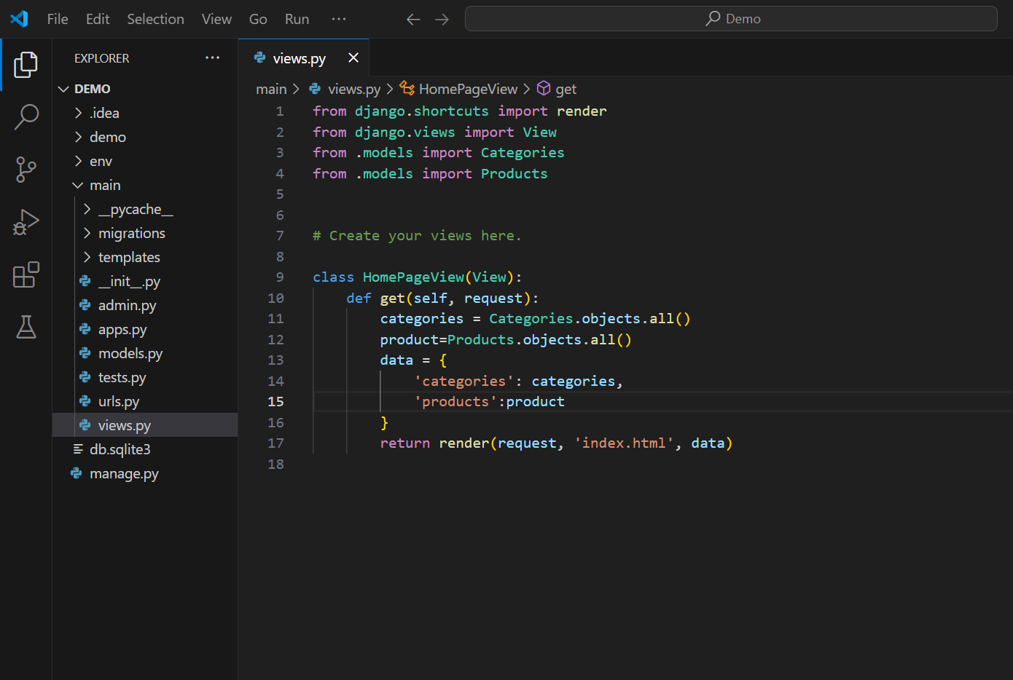
Retrieve Product from models in home page
In main app
Import Products table from models.py
file
Get all products from
Products table
Add product on data trouple section
Open views.py file

Slide 36
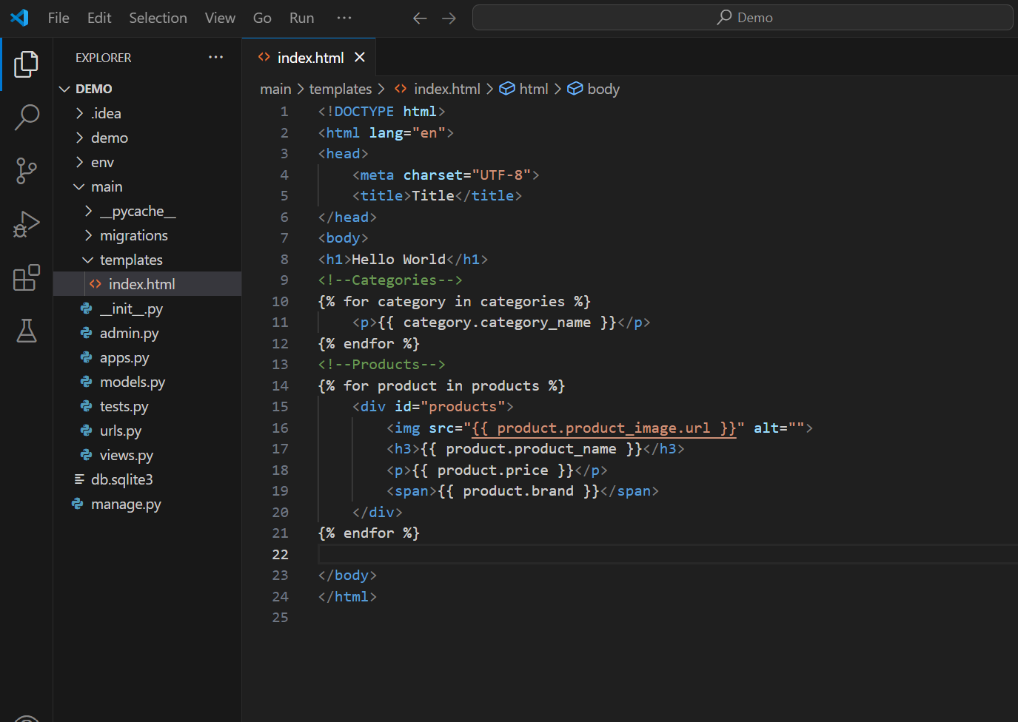
Product Display in index.html
In Main app folder
In templates folder
Open index.html file
Start products
For loop
Under for loop
Type Html code
Run your server and check any error and solve error

Slide 37
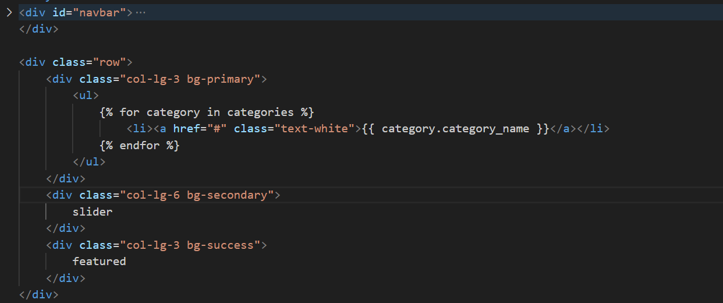
For loop in html file

